Slide 1
DATA SCIENCE Probability and Bayes’ Theorem

Slide 2
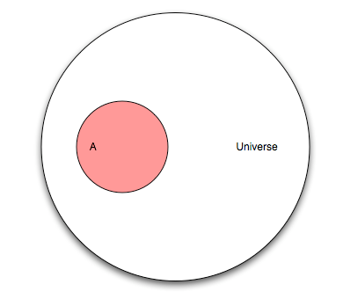
Probability
Let’s pretend you flipped a coin and haven’t looked at the result. This diagram represents the “universe” of all possible outcomes, also known as events. This universe is known as the sample space.
Q: What are the mutually exclusive events that make up the sample space for a coin flip?
A: Heads and tails

Slide 3
Probability
Let’s now pretend that our universe involves a research study on humans. Event “A” is people in that study who have cancer.
Q: If our study has 100 people and “A” has 25 people, what is the probability of A?
A: P(A) = 25/100 = 0.25
Q: What is the max probability of any event?
A: 1

Slide 4
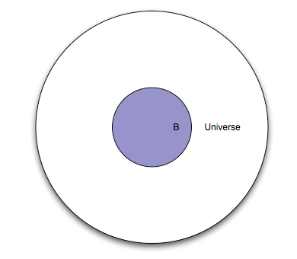
Probability
This represents the same set of people, except everyone in the study is given a test. Event “B” is everyone in the study for whom the test is positive.
Q: What portion of the diagram represents the subset of people with a negative test?
A: The white area between the smaller circle and the larger circle.

Slide 5
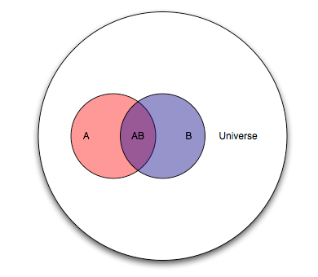
Probability
Because “A” and “B” are events from the same study, we can show them together.
Q: How would you describe the “cancer status” and “test status” of people in each portion of the diagram (by color)?
A: Pink: cancer, negative test
Purple: cancer, positive test
Blue: no cancer, positive test
White: no cancer, negative test

Slide 6
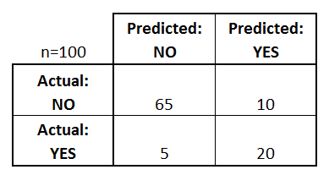
Probability
The purple section is known as the intersection of A and B, denoted as P(AB).
Thinking of this test as a classifier for predicting cancer, draw the confusion matrix.
10
20
5

Slide 7
Probability
Q: Let’s pick an arbitrary person from this study. If you were told their test result was positive, what is the probability they actually have cancer?
A: 20/30
This is the conditional probability of A given B, denoted as P(A|B).
P(A|B) = P(AB) / P(B) = (20/100) / (30/100)
10
20
5

Slide 8
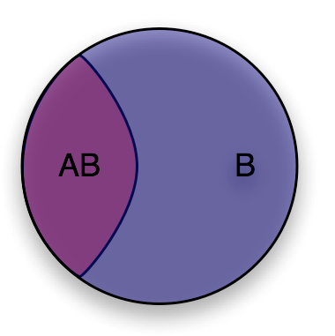
Probability
You can think of conditional probability as “changing the relevant universe.” P(A|B) is a way of saying “Given that my entire universe is now B, what is the probability of A?”
This is also known as transforming the sample space.

Slide 9
Probability
10
20
Q: Let’s pick another arbitrary person from this study. If you were told they have cancer, what is the probability they had a positive test result?
A: P(B|A) = P(AB) / P(A) = 20/25
5

Slide 10
Bayes’ theorem
Deriving Bayes’ theorem:
We know: P(A|B) = P(AB) / P(B) and P(B|A) = P(AB) / P(A)
Thus: P(AB) = P(A|B) * P(B) = P(B|A) * P(A)
Rearrange to get Bayes’ theorem: P(A|B) = P(B|A) * P(A) / P(B)

Slide 11
Bayes’ theorem
Exercise:
1% of women at age forty who participate in routine screening have breast cancer. 80% of women with breast cancer will get positive mammograms. 9.6% of women without breast cancer will also get positive mammograms.
A woman in this age group had a positive mammography in a routine screening. What is the probability that she actually has breast cancer?

Slide 12
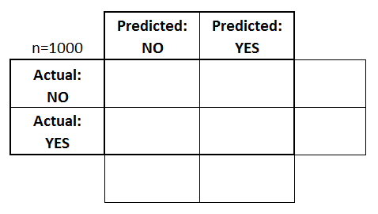
Bayes’ theorem
Part 1: Draw a confusion matrix

Slide 13
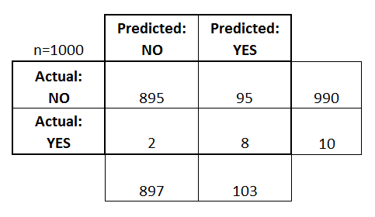
Bayes’ theorem
Part 1: Draw a confusion matrix
Given a positive test result, what is the probability of cancer?
8/103 = 7.8%

Slide 14
Bayes’ theorem
Part 2: Review of Terminology
What is the sensitivity of the test?
TP / actual yes = 80%
What is the specificity of the test?
TN / actual no = 1 - 9.6% = 90.4%
Prevalence = actual yes / total = 1%
Precision = TP / predicted yes = 7.8%

Slide 15
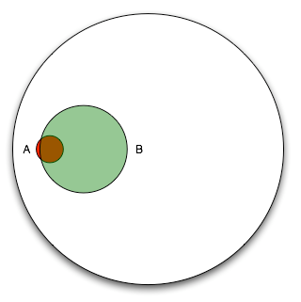
Bayes’ theorem
Part 3: Use Bayes’ theorem
P(A|B) = P(B|A) * P(A) / P(B)
Event A is “has cancer.” Event B is “positive test.”
What is P(A|B)?
P(B|A) = 0.80
P(A) = 0.01
P(B) = 0.103
P(A|B) = 0.80 * 0.01 / 0.103 = 7.8%

